Slide 1
Database
To store a data efficiently

Slide 2
Database Provider
Text
SQL Based
Many more……

Slide 3
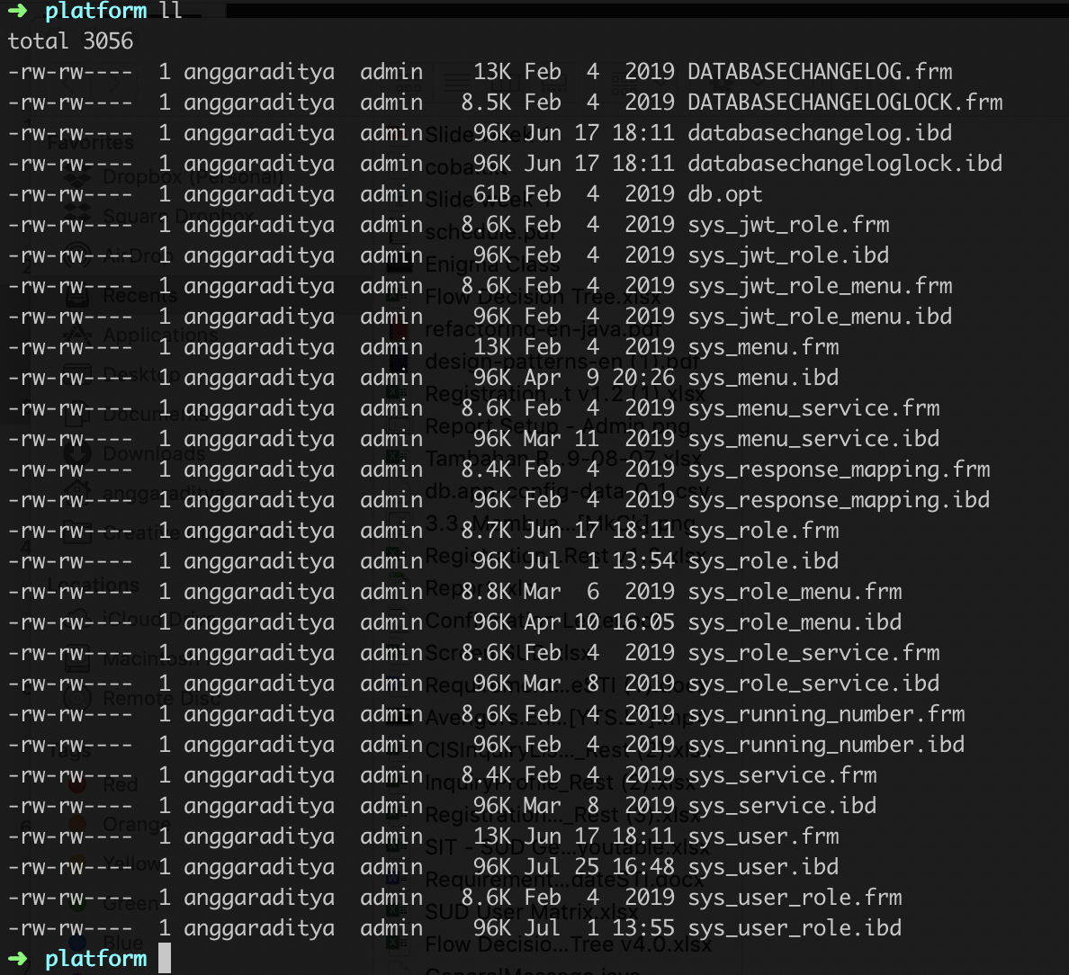
Where do they store the data?
Text
Still in here!!! As a file

Slide 4
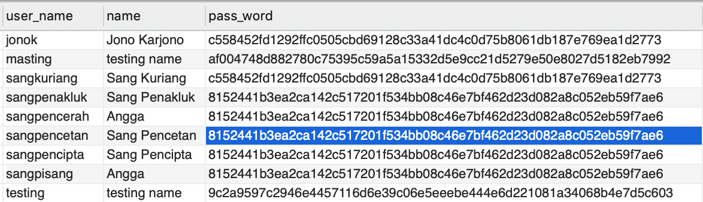
Table & fields & Records
Text
Fields
Records
Table

Slide 5
SQL : Structure query language

Slide 6
SQL
Text

Slide 7
Text
Learn By Doing!! This presentation won’t fit the whole SQL
Angga Raditya

Slide 8
Normalizations

Slide 9
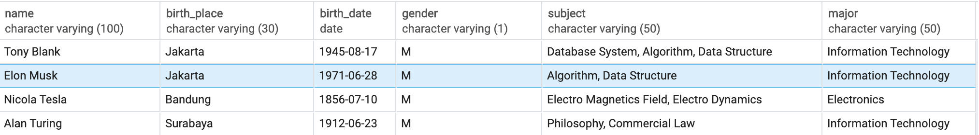
The Problems
Text
Student in a Enigma University
Electrical Engineering
Try Query Student who learn “Algorithm”

Slide 10
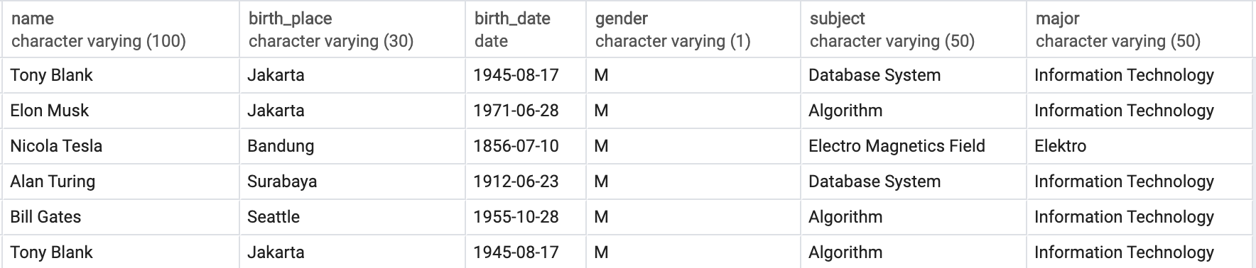
Why Normalized?
Text
Electrical Engineering
Imagine there is 2000 student in that place, and the subject is 30 each major, there is 5 Major
2000*30*5=300000 records
There will be Hundreds Thousand word “Algorithm”, “Information Technology”, etc…

Slide 11
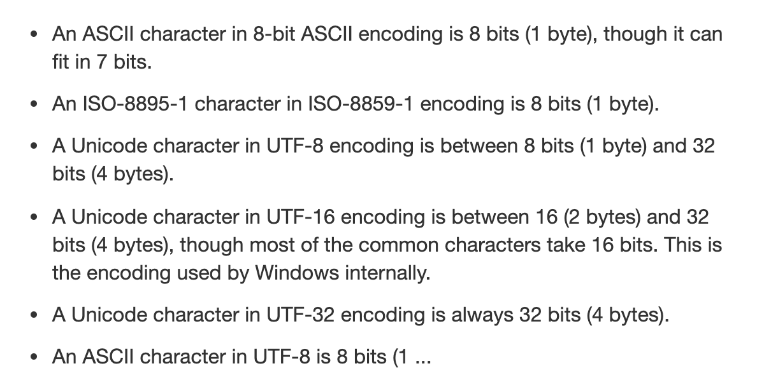
Why Normalized?
Text
300000 word of “Algorithm” will use
“Algorithm” = 9 * 1 byte = 9 byte
300000*9 byte = 2700000 byte=2.7 MB
How About “Information Technology”, “Database System”, etc……

Slide 12
Why Normalized?
Text
Back then, this box is F%#&ing EXPENSIVE!!!

Slide 13
Text
Reduce Duplication, lets make it clean and easy to understand,
Lets do normalisation
Angga Raditya

Slide 14
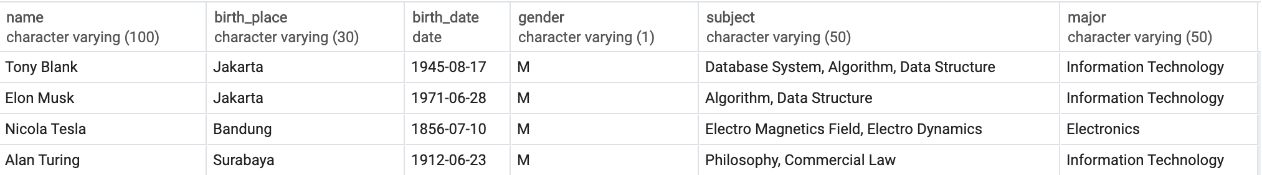
Unnormalized form ( UNF )
Text
Electrical Engineering
Must be Atomic

Slide 15
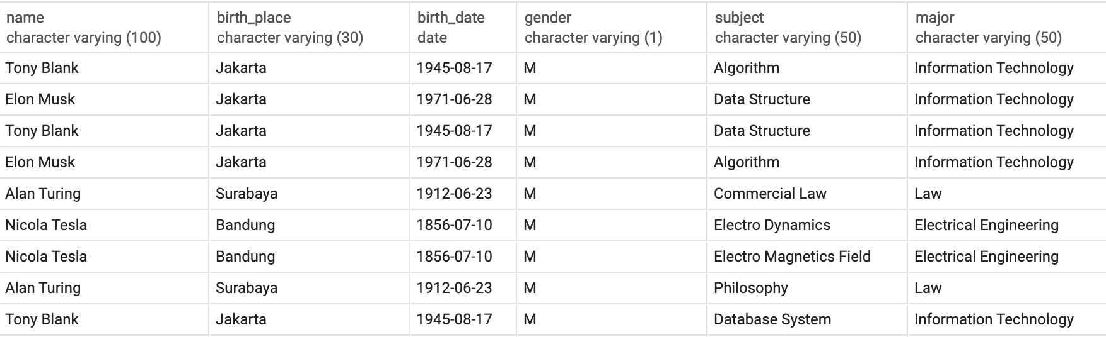
1nf
Text

Slide 16
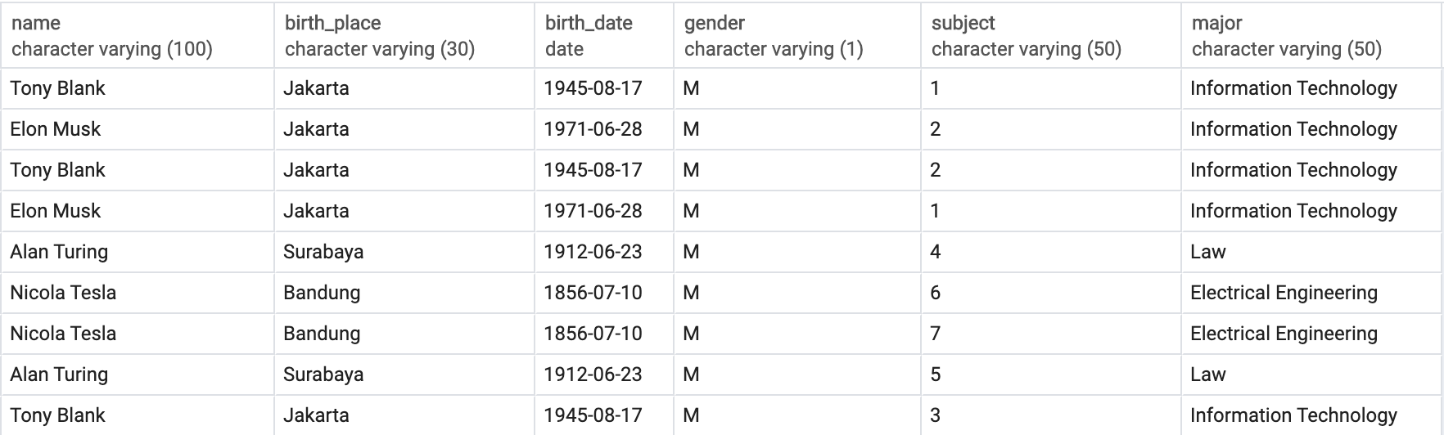
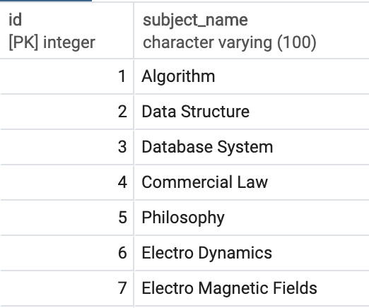
2NF
Text

Slide 17
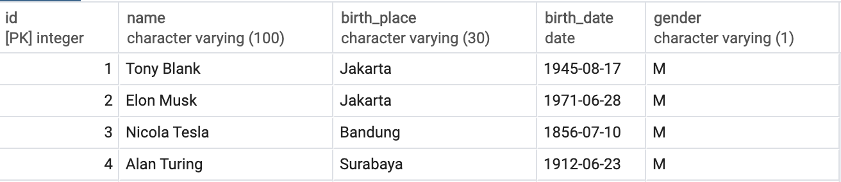
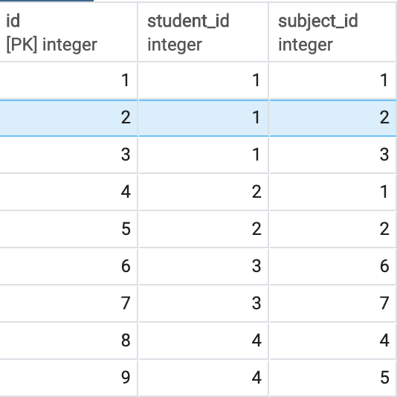
3NF
Text

Slide 19
ACID

Slide 20
ACID
Text

Slide 21
A.C.I.D
Text
Atomicity : A transaction is a single unit of operation. You either execute it entirely or do not execute it at all. There cannot be partial execution.
Consistency : Once the transaction is executed, it should move from one consistent state to another.
Isolation : Transaction should be executed in isolation from other transactions (no Locks). During concurrent transaction execution, intermediate transaction results from simultaneously executed transactions should not be made available to each other. (Level 0,1,2,3)
Durability : After successful completion of a transaction, the changes in the database should persist. Even in the case of system failures.

